Slide 1
Capstone Project – Car Accident Severity Prediction
Anubhav Roy

Slide 2
Background
Seattle Department of Transportation (SDOT) is on a mission to deliver a
transportation system that provides safe and affordable access to the
places. The council’s goal is to create safe transportation environments and
eliminate serious and fatal crashes in Seattle. Making sure people can get
around the growing city safely is the council’s top priority.
It becomes a growing need if there is something in place that could warn
road commuters, given the weather and the road conditions about the
possibility of getting into a car accident and how severe it could be. Based
on such alerts, people could drive more carefully or even change their travel
if they are able to.
around the growing city safely is the council’s top priority.

Slide 3
Stakeholders & beneficiaries
The severity impact prediction model (which is scope of this project) could
be published as a REST API or web service (future scope of work) for the
Seattle Department of Transportation (SDOT). The SDOT may have options to
own or to subscribe to this service. By inputting necessary data to the service
it could receive predictions regarding severity of accidents. This would help
SDOT formulate traffic routing decisions or alerts in the geography under its
monitoring.
Daily commuters and road travelers would find it much convenient to know
about live traffic information, traffic diversion alerts and notifications when
they tune with the SDOT broadcast channels. It would help save everyone’s
precious time, hectic travels and help avert mishaps or accidents due to
such forewarnings.

Slide 4
Methodlogy
We introduce here the research methods and data source used for the analysis. We would discuss in key highlights in below sections about the
data, choice of variables, modelling methods and how they would help answer the problem statement. The methodology steps essentially are
as follows:
Data collection and understanding
• Data source
• Data understanding
Data preparation
• Basic insight of dataset
• Feature selection
• Data cleansing
• Data transforming
• Test of correlation and significance
• Conclusion of important variables
Model development
• Algorithms and empirical findings
• Results summary
Discussion
Conclusion
References
Acknowledgement

Slide 5
Data Understanding
We have used shared data of Seattle city as basis to deal with the accidents data
(source: http://data-seattlecitygis.opendata.arcgis.com/datasets/ 5b5c745e0f1f48e7a53acec63a0022ab_0.csvlance at the CSV file, we could see what type of data we have with us. The
label for the data set is Severity, which describes the fatality of an accident. The
remaining columns have different types of attributes. Also noticed that the data
had some unbalanced attributes which need to be normalized during next steps.
We also used the collisions meta data available for about 16 years to understand
the nature of all attributes. Having about 2.21L data observations, we could notice
that a split of these could be used to train and test the prospective model.

Slide 6
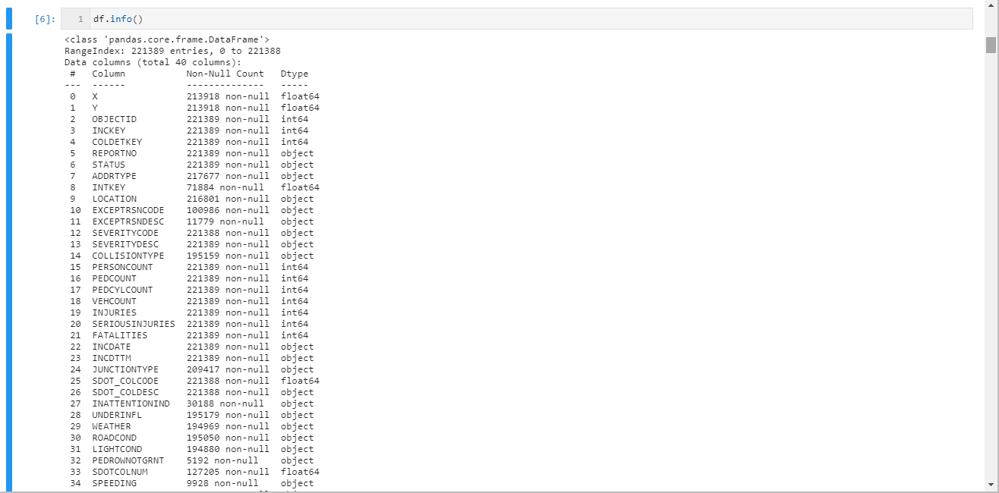
Data Preparation (Data Fields)
In the given dataset, SeverityCode is
identified as the target variable
(labelled or dependent) while rest of
the fields are construed as
independent variables or the
attributes.
The case objective with the given
data, does qualify it as a
classification problem of the
supervised machine learning.
All columns that could influence the
cause and impact of an accident
need to be selected for training and
testing the model.

Slide 7
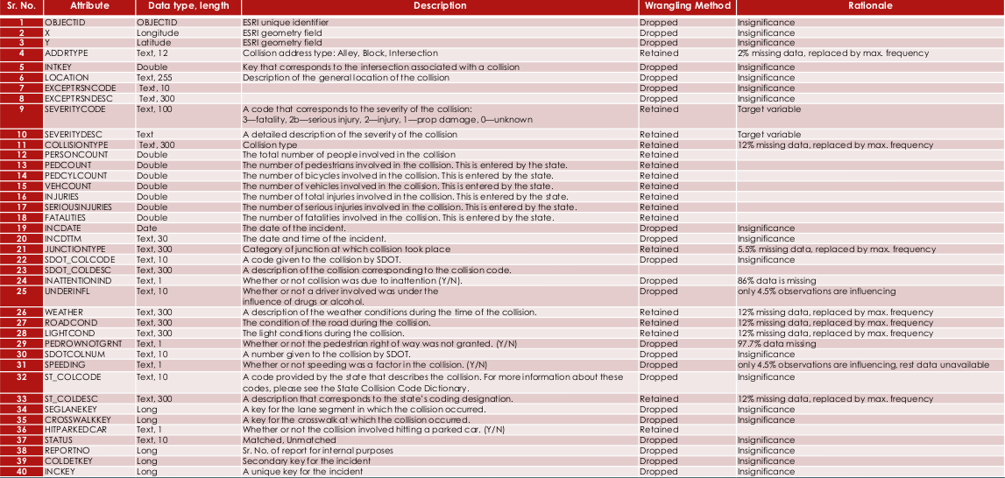
Data Preparation (Rationale)

Slide 8
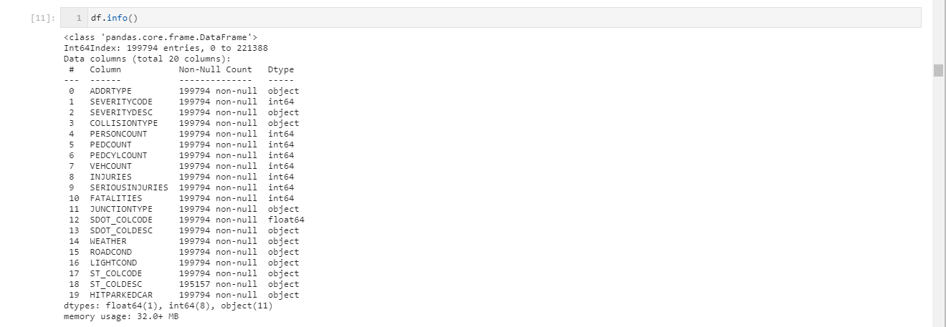
Data Preparation (Cleansing)
The next step in data cleansing would be to check and make sure that all data is in the correct format
(int, float, text or other). To use categorical variables for regression analysis, indicator variables (or
dummy variable) were used for transforming categorical variables into binary (0s and 1s) or numeric
values.

Slide 9
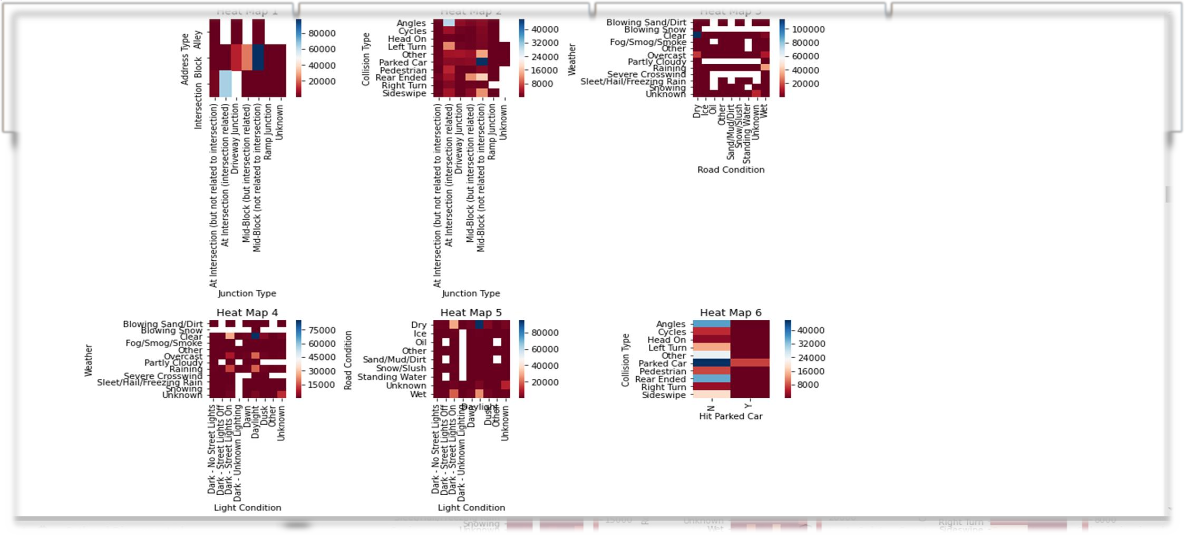
Data Preparation (Correlations)
To get a better measure of the important characteristics, we looked at the correlation of attributes vis-a-vis target variable i.e. Accident Severity. The correlations are depicted by constructing heat maps between pairs of the variables.

Slide 10
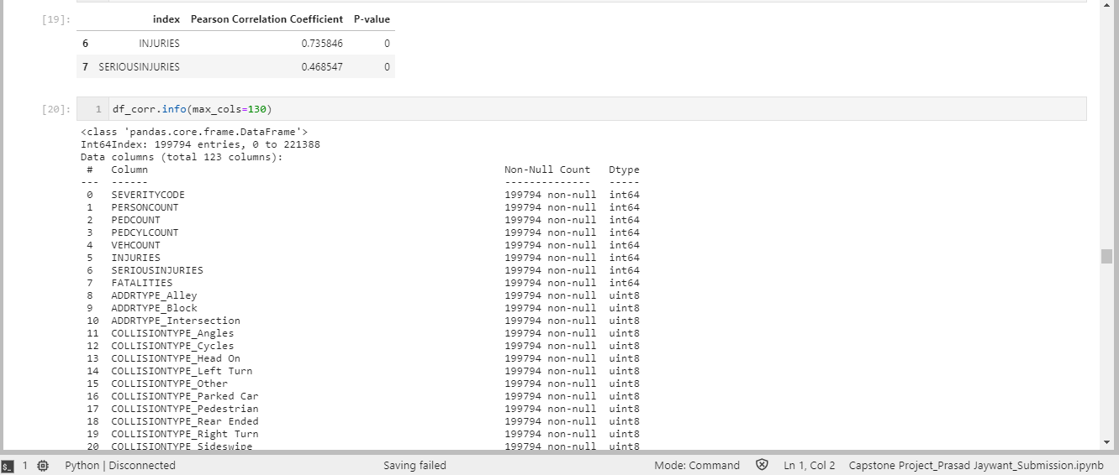
Data Preparation (Important Variables)
Here we have a better idea of what our data looks like and which variables are important for
consideration while predicting the ‘Severity’ class.

Slide 11
Model Development
A Model would help us understand the exact relationship between different variables and
how these variables are used to predict the result. We developed Classification model based
on following algorithms that would predict the severity of an accident using the variables or
Features.
Logistic Regression:
It produces a formula that predicts the probability of a class label as function of the
independent variables. Logistic regression fits a special s-shaped curve by transforming the
numeric estimate into a probability with the sigmoid function σ.
K-Nearest Neighbors (KNN):
K-Nearest Neighbors is an algorithm for supervised learning, where the data is 'trained' with
data points corresponding to their classification. Once a point is to be predicted, it considers
the 'K' nearest points to it to determine its classification.
Decision Trees:
Based on the 'minimizing entropy (degree of randomness)' and 'maximising information gain
(level of certainty)' criteria.

Slide 12
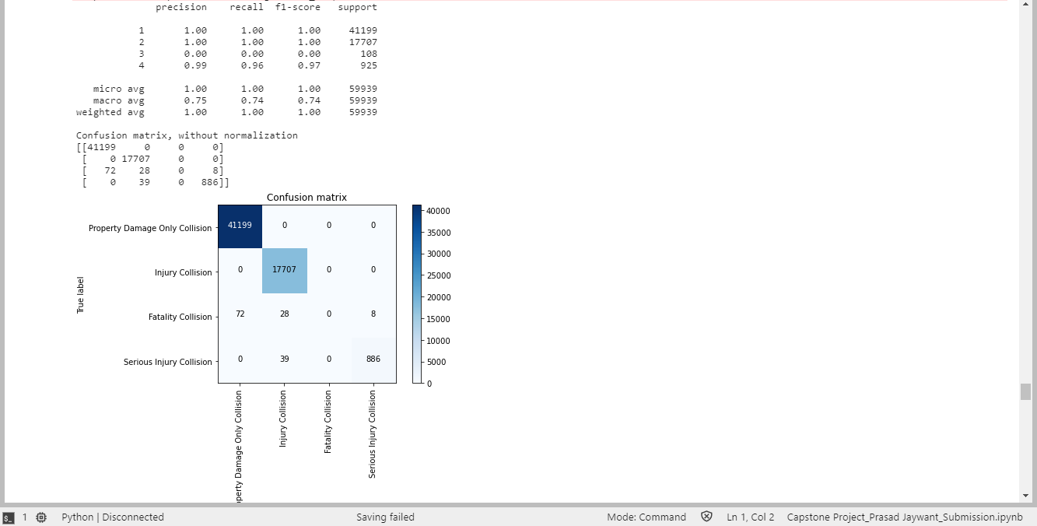
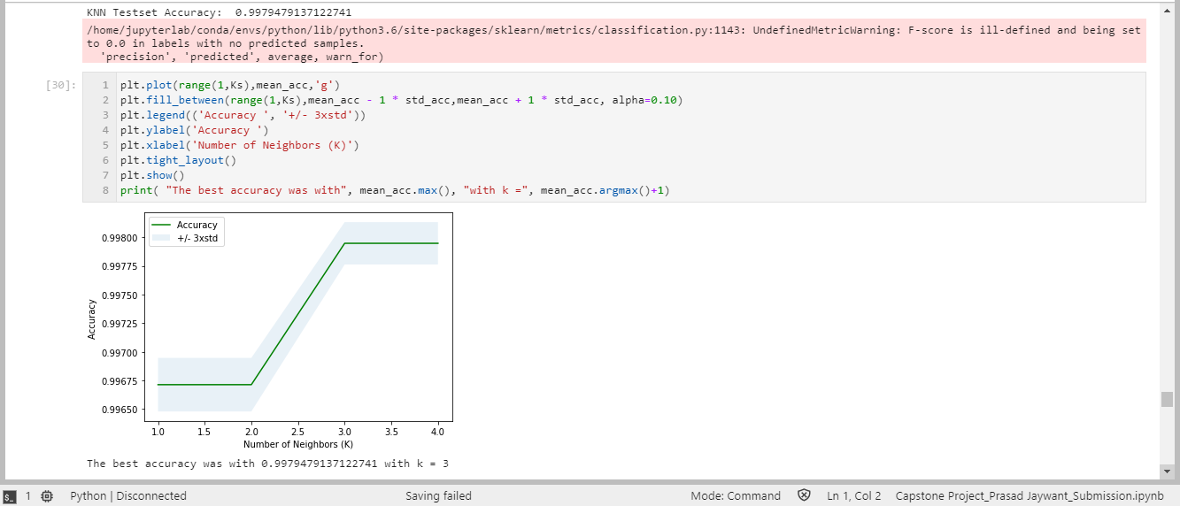
Model Development (Evaluation)
Logistic Regression
K-Nearest Neighbors

Slide 13
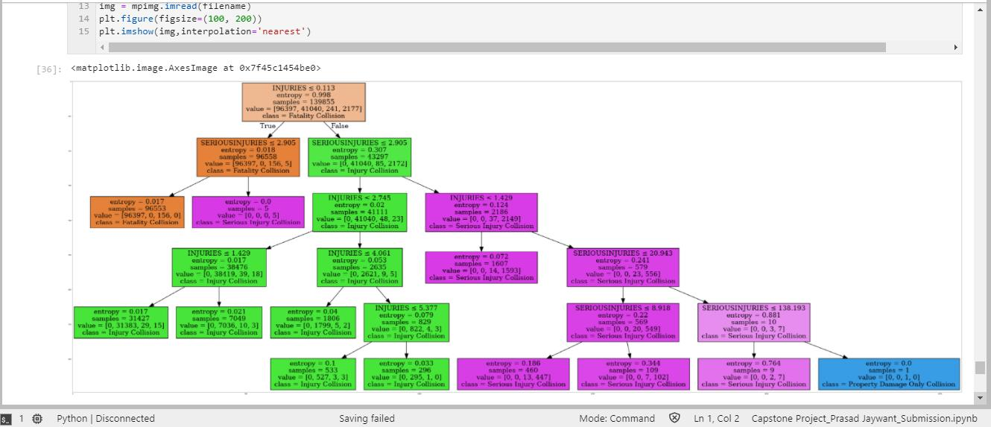
Model Development (Evaluation)
Decision Trees

Slide 14
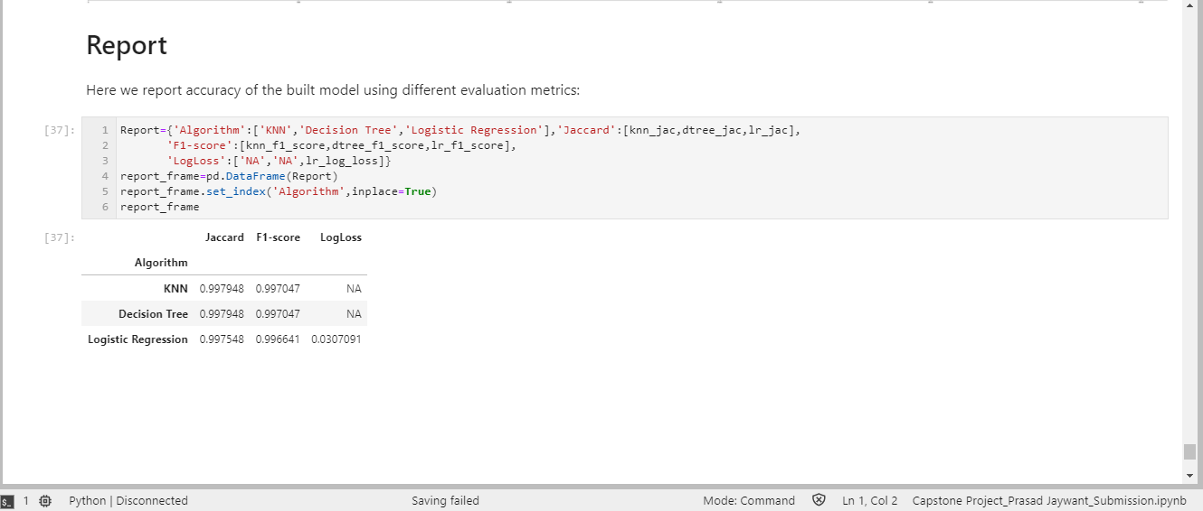
Model Development (Results Summary)
The accuracy of the models built using different evaluation metrics can be summarized as follows;

Slide 15
Discussion
The data set is well structured and offers good number of useful observations (about
2L). The data wrangling was mostly accomplished by substituting the values with
maximum frequency of the available data.
The correlation method shortlisted some variables such as injuries, which are related
to the impact of accident, contributed moderately to the severity. Though the
influence of causal factors such as weather, road/light conditions on accident
severity was expected, they seemed not significant in contribution as was suggested
by the low values (<0.4) of Pearson coefficients. Correlation of address type and
junction type to severity was also not significantly evident.
We had split given data set into 70:30 ratio for training/testing the model. Model’s
prediction accuracy seems acceptable due to high Jaccard and F1-score and near-
zero Log loss values.

Slide 16
Conclusion
The model has fairly taken care of the missing values which are of common
occurrence in the real data gathering scenarios. The selected algorithms are
in sync with the prediction accuracy, thereby poses high confidence in
predicting the real cases. As envisioned in section 1.4, the model seems
capable of implementing it at the client site. Also poses high potential for
extending it to more city councils having similar data sources.
In the roadmap ahead, the model could be enriched with deeper analysis of
causation factors, although the focus at present was more on the correlations
within given data. The model deployment and integration with client systems
could be the next steps of project implementation. With study of advanced
Python capabilities, statistical/probabilistic algorithms and graphical
visualizations, it could provide opportunity for iterative improvements in the
model.

Slide 17
References
Preparation of this report must cite help of valuable references as follows;
✓ IBM Data Science Professional Certificate Course – All 9 modules, labs,
tutorials and links therein: https://www.coursera.org/professional-
certificates/ibm-data-science
✓ IBM Watson Studio Resources: https://cloud.ibm.com/resources
✓ Github Repository: https://github.com/
✓ Pandas open source literature: http://pandas.pydata.org
✓ Scikit Learn open source content: https://scikit-learn.org/
✓ Technology community sites: https://stackoverflow.com/
and many more from Google Search.

Slide 18
Acknowledgement
I must thank all the mentor team members; Alex Aklson, Polong Lin, Romeo Kienzler,
Svetlana Levitan, Joseph Santarcangelo, Hima Vasudevan, Rav Ahuja, Saeed
Aghabozorgi for their valued guidance, exciting videos and structuring
comprehensive labs and the tutorials. The illustrations, case studies showcased in
these sessions helped me understand the concepts and practical applications of
Data Science tools and techniques.
I also take this opportunity to thank my peers who took out their time to review my
graded submissions and provided the valued feedbacks. I owe my special thanks to
the contributors who are active in posting replies to various queries or issues being
raised in the discussion forums. Their efforts in helping people to come out of the stuck
up or no-clue situations are much appreciated.

Slide 19
Thank You

